Slide 1
Digital Literacy
Ethno-cultural Seniors:
Staying Healthy, Well and Safe
at Home in Communities

Slide 2
Topics of Discussion
Introduction
Terminology
Browsers
Functions
Accessories
Myth Busters
Q&A
Resources

Slide 3
Terms
Definitions, Examples

Slide 4
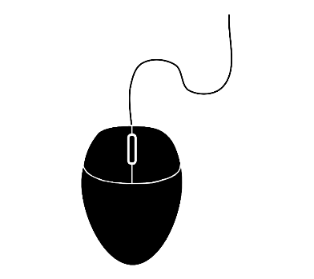
Mouse | Trackpad | Touchscreen
A small device that is used with a single hand to control the position of the cursor on the computer screen. Moving the mouse will move the cursor on your screen. | A small touch sensitive area on a computer that allows you to control the cursor on the computer screen. Sliding your finger on the trackpad will move the cursor on your screen. | A type of screen that replaces the need to have a cursor and mouse; allowing you to interact with a device by touching areas on the screen.
Pressing and releasing the left-click button on a mouse to select or activate the designated area. For more advanced features or functions, press and release the right-click button. |  | Sometimes touching and holding your finger in place for several seconds can activate advanced features.

Slide 5
Applications

Slide 6
Streaming
Did you know?
You are streaming when you are watching YouTube videos, Facebook videos, Spotify and any other music or video services that use internet.
Cable TV providers also offer TV over the internet, and that is still considered streaming!
Transmitting or receiving data over an internet enabled device, especially video and audio material.

Slide 7
Browsers

Slide 8
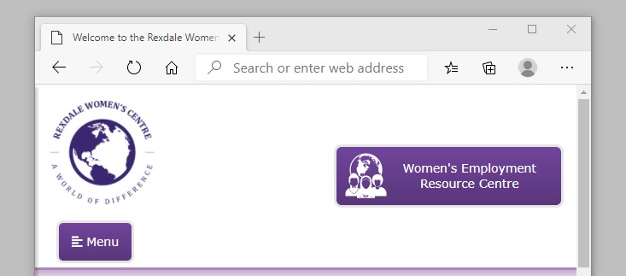
Back Arrow
Reload / Refresh
Home
Magnifying Glass
Minimize
Maximize
Close
New Tab

Slide 9
Address Box
Web Address

Slide 10
Web Address
.org
.ca
.com
.gc.ca
.net
.co.uk

Slide 11
Download | Upload | Share
The process of receiving a file over the internet to your device. It can also refer to the transfer of information from one computer system to another. | To transfer something, like files or data, from one digital device to the memory of another device. | This button is used to share things like web pages and even photos to other contacts.

Slide 12
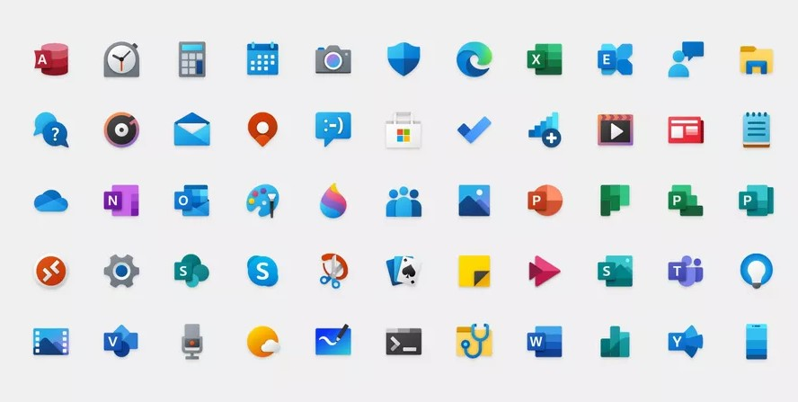
Icons | Link(s) | Scrolling
Icons are visual representations for applications. Most commonly, starting an application is done by clicking on or touching an icon. | A shortened variation of hyperlink. It is usually a word or button that, if clicked, will take you the website it related to. | The act of moving displayed text or graphics up and down on a computer-like-device to view all parts.
 | Example: http://www.rexdalewomen.org

Slide 13
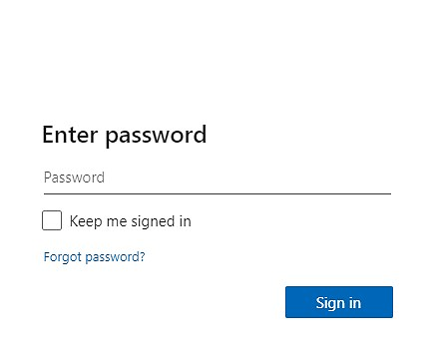
Faded Text
Sign in / Login

Slide 14
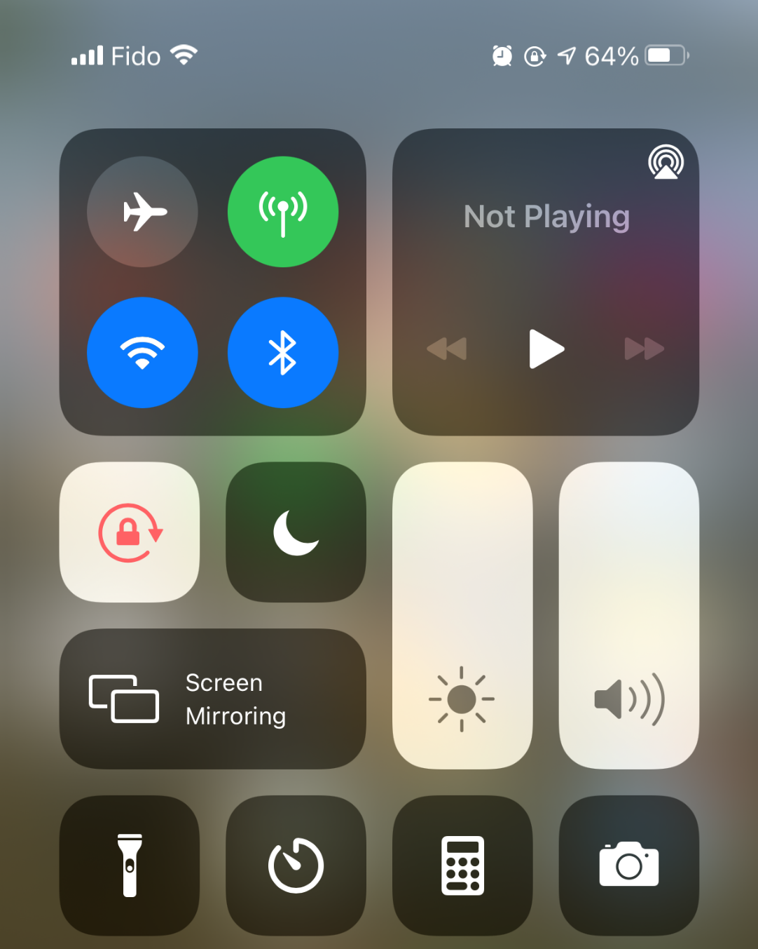
Airplane Mode
Wi-Fi
Bluetooth
Do Not Disturb
Brightness
Volume
Calculator
Camera

Slide 15
Options
Settings

Slide 16
Menu

Slide 17
Charger Cube
Used for charging various devices
Tip: if you buy a new device and a new charging cube is provided with it, you should replace the old one with the new one.
You can continue to use the cable that you already have, provided it does not have any frays or exposed wires that may be unsafe and/or cause fires.

Slide 18
Myth 1
Charging your device overnight is bad

Slide 19
Myth 2
Charge your battery fully, then let it completely drain

Slide 20
Myth 3
Don’t use your device while it’s charging

Slide 21
Myth 4
Leaving your device on 24/7

Slide 22
Questions & Answers
Do you have questions about the technology you use?

Slide 23
Thank you
Your feedback is appreciated

