Slide 1
SAFETY
Ethno-cultural Seniors:
Staying Healthy, Well and Safe
at Home in Communities

Slide 2
Topics of Discussion
1. Introduction
2. Masks & Face Shields
3. Hand washing
4. Sanitizer
5. Gloves
6. Vaccines
7. How do you stay safe?

Slide 3
Masks
Fabric or Disposable
Wearing masks
Face shields
When should I wear a mask?

Slide 4
According to the Public Health Agency of Canada a mask should be worn:
“to protect yourself and others… to prevent the spread of COVID-19”
www.canada.ca/en/public-health/services/diseases/2019-novel-coronavirus-infection/prevention-risks/about-non-medical-masks-face-coverings.html#a1
Notes:
https://www.canada.ca/en/public-health/services/diseases/2019-novel-coronavirus-infection/prevention-risks/about-non-medical-masks-face-coverings.html#a1

Slide 5
Disposable Masks
Did you know that disposable masks are mostly made of plastic?
If you must use a disposable mask, always dispose of it properly in a garbage container.
Did you know that disposable masks are also known as single-use masks?

Slide 6
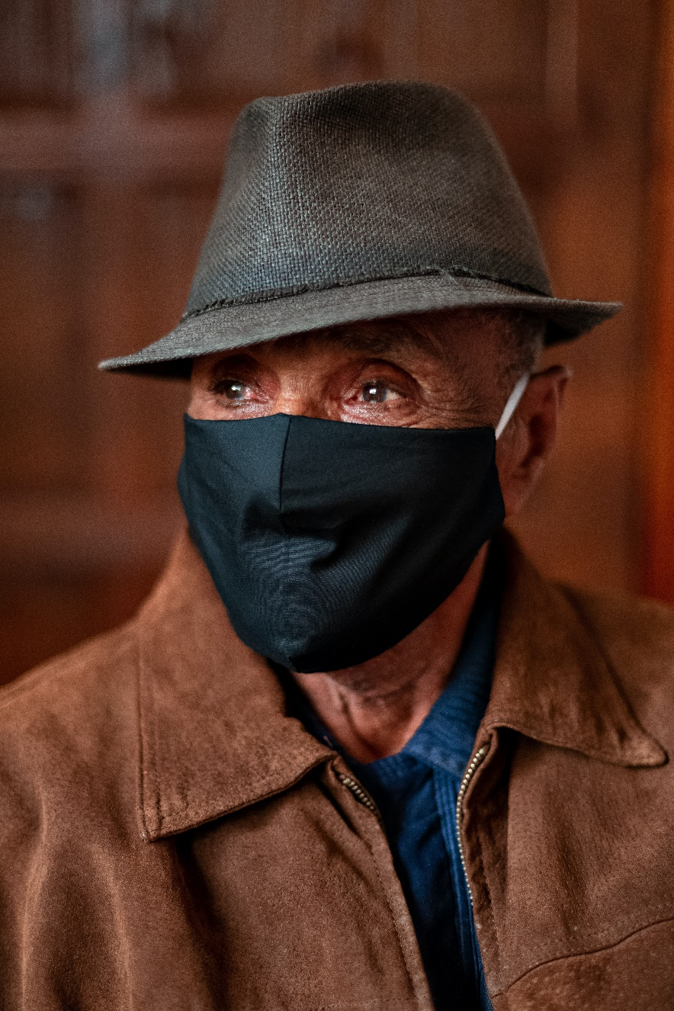
Fabric Masks
Did you know that choosing a reusable mask or face covering, you can help prevent the spread of COVID-19, while also doing your part to reduce environmental impact?
They can be homemade or purchased.
Should be made of a tightly woven material fabric.

Slide 7
How to Wear a Mask
In the safest way possible

Slide 8
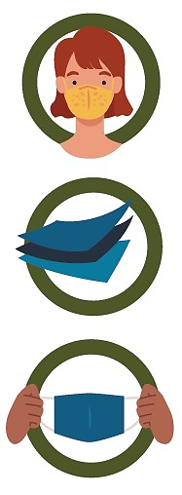
Do’s
Wear a non-medical mask or face covering to protect yourself and others.
Ensure the mask is made of at least 3 layers, including 2 layers of tightly woven fabric, with a filter or filter fabric between layers.
Inspect the mask for tears or holes
Notes:
Source: Government of Canada
https://www.canada.ca/content/dam/hc-sc/documents/services/publications/diseases-and-conditions/covid-19-safely-use-non-medical-mask-face-covering/covid-19-safely-use-non-medical-mask-face-covering-en.pdf

Slide 9
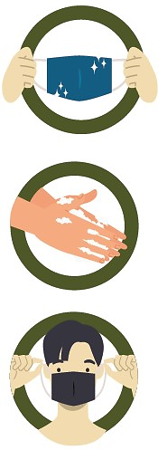
Do’s
Ensure the mask or face covering is clean and dry.
Wash your hands or use alcohol-based hand sanitizer before and after touching the mask or face covering.
Use the ear loops or ties to put on and remove the mask.
Notes:
Source: Government of Canada
https://www.canada.ca/content/dam/hc-sc/documents/services/publications/diseases-and-conditions/covid-19-safely-use-non-medical-mask-face-covering/covid-19-safely-use-non-medical-mask-face-covering-en.pdf

Slide 10
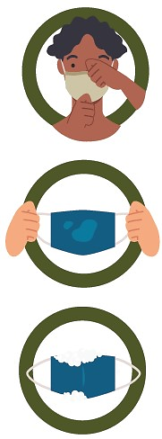
Do’s
Ensure your nose, mouth, and chin are fully covered.
Replace and launder your mask after each use, or whenever it becomes damp or dirty.
Wash your mask with hot, soapy water and let it dry completely before wearing it again.
Notes:
Source: Government of Canada
https://www.canada.ca/content/dam/hc-sc/documents/services/publications/diseases-and-conditions/covid-19-safely-use-non-medical-mask-face-covering/covid-19-safely-use-non-medical-mask-face-covering-en.pdf

Slide 11
Do’s
Store re-usable masks in a clean paper bag until you wear it again.
Do discard masks that cannot be washed in a garbage bin after use.
Notes:
Source: Government of Canada
https://www.canada.ca/content/dam/hc-sc/documents/services/publications/diseases-and-conditions/covid-19-safely-use-non-medical-mask-face-covering/covid-19-safely-use-non-medical-mask-face-covering-en.pdf

Slide 12
Don’ts
Wear masks with exhalation valves or vents.
Wear a loose mask.
Touch the mask while wearing it.
Remove the mask to talk to someone.
https://www.canada.ca/content/dam/hc-sc/documents/services/publications/diseases-and-conditions/covid-19-safely-use-non-medical-mask-face-covering/covid-19-safely-use-non-medical-mask-face-covering-en.pdf
Notes:
Source: Government of Canada
https://www.canada.ca/content/dam/hc-sc/documents/services/publications/diseases-and-conditions/covid-19-safely-use-non-medical-mask-face-covering/covid-19-safely-use-non-medical-mask-face-covering-en.pdf

Slide 13
Don’ts
Hang mask from your neck or ears.
Share your mask.
Leave your used mask within the reach of others.
Reuse masks that are damp, dirty or damaged.
https://www.canada.ca/content/dam/hc-sc/documents/services/publications/diseases-and-conditions/covid-19-safely-use-non-medical-mask-face-covering/covid-19-safely-use-non-medical-mask-face-covering-en.pdf
Notes:
Source: Government of Canada
https://www.canada.ca/content/dam/hc-sc/documents/services/publications/diseases-and-conditions/covid-19-safely-use-non-medical-mask-face-covering/covid-19-safely-use-non-medical-mask-face-covering-en.pdf

Slide 14
Face Shields
Face shields do not replace masks or face coverings.
A face shield is used to protect the eyes of the person wearing it. Using a face shield without a mask won’t protect:
You from potentially inhaling infectious respiratory droplets exhaled by others
Others from your infectious respiratory droplets, as they can escape around the face shield

Slide 15
Face Shields continued…
If you’re unable to wear a mask or face covering, you may want to wear a face shield. Choose one that extends around the sides of the face and below the chin. You’ll still need to:
Maintain physical distancing of 2 metres
Practise good hand hygiene, especially if you touch the face shield

Slide 16
Gloves
Do I have to wear gloves?
How many times can I use the same gloves?
Dispose of gloves in garbage after use.
If I do wear gloves, how do I remove them without increasing my chance of cross contamination?
Let’s talk about gloves…

Slide 17
Steps to Take Off Gloves

Slide 18
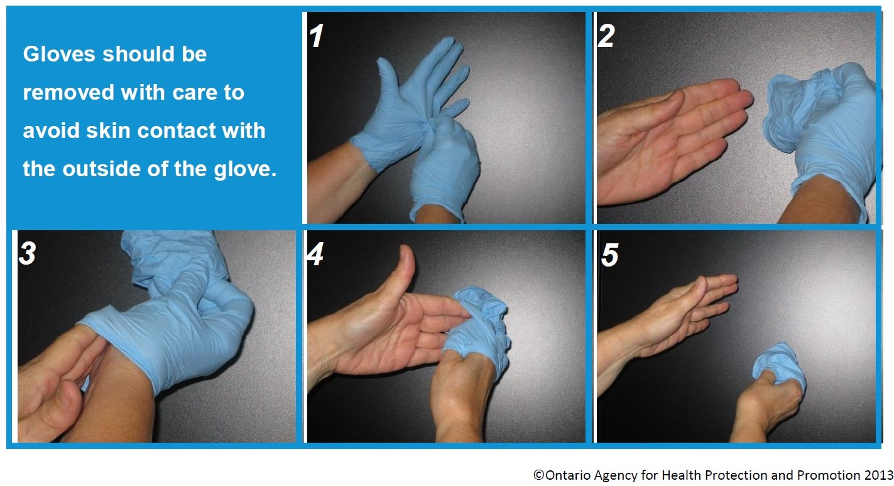

Slide 19
Sanitizer
Always Sanitize Your Hands
After you:
Sneeze, cough or blow your nose
Use the washroom or change diapers
Handle garbage
Play outdoors
Before and after you:
Prepare or eat food
Touch a cut or open sore
Useful when soap and water are not available.
When preparing food, hand sanitizer should not be used, hand wash with soap and water.
Use 70-90% alcohol-based hand sanitizer.
Do not air dry.

Slide 20
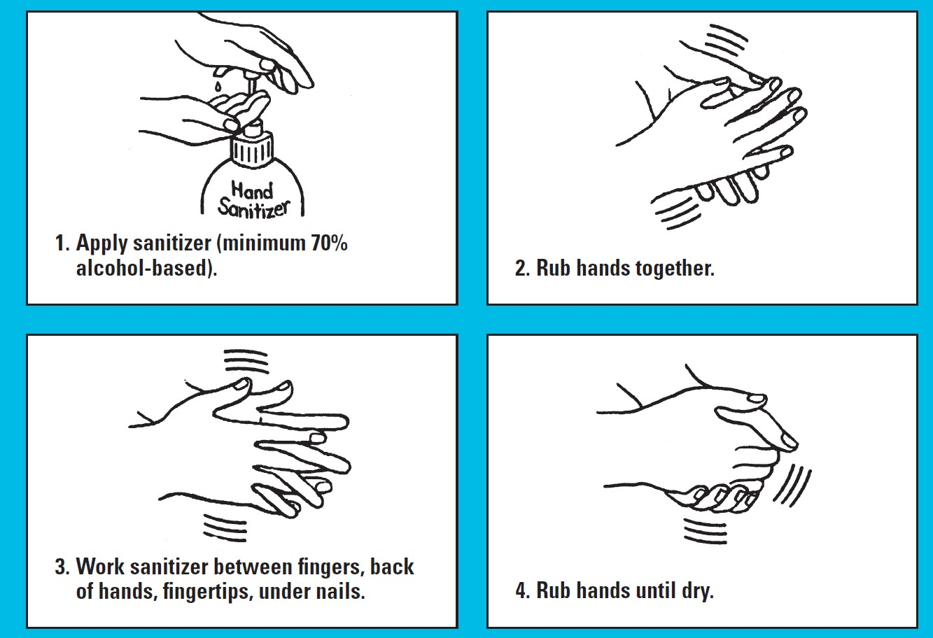
For more information from Toronto Public Health you can call 416.338.7600 or visit toronto.ca/health
Dry skin is not uncommon when you clean your hands often, especially during the winter. Try using lotion after cleaning your hands!

Slide 21
Hand Washing
Always Wash Your Hands
After you:
Sneeze, cough or blow your nose
Use the washroom or change diapers
Handle garbage
Play outdoors
Before and after you:
Prepare or eat food
Touch a cut or open sore
When clean running water is available, wash your hands with plain soap and water and dry thoroughly.
The soap you use does not have to be antibacterial when following proper hand washing.

Slide 22
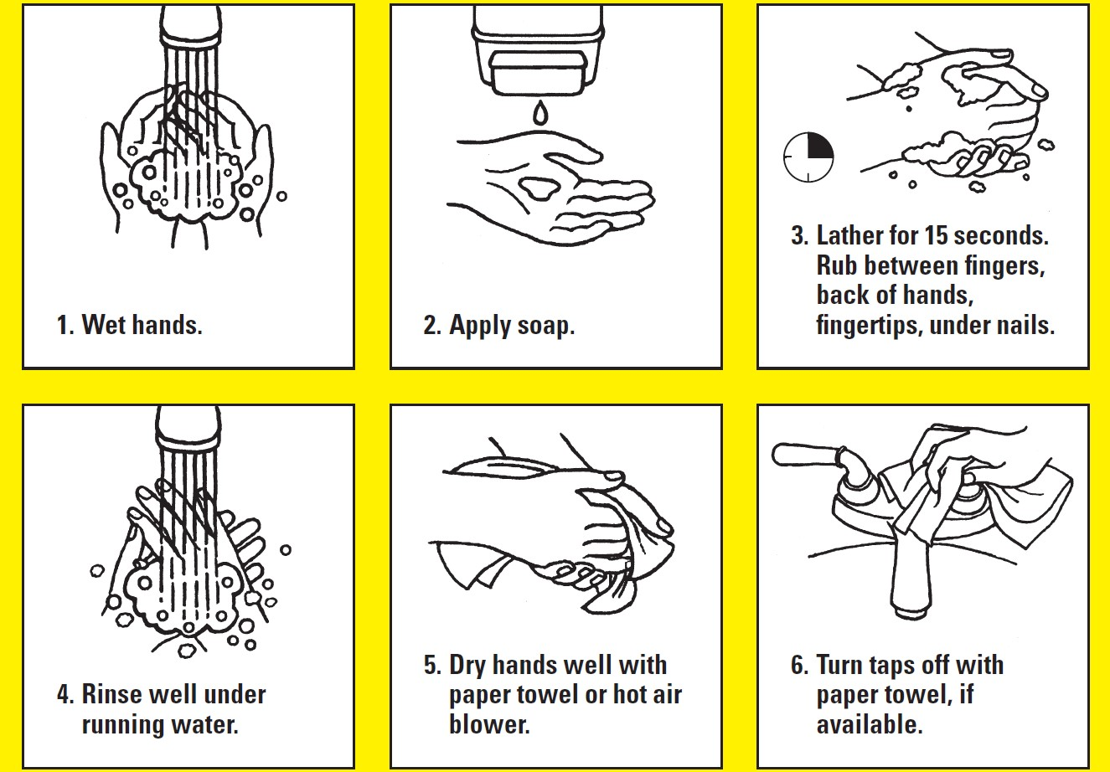
For more information from Toronto Public Health you can call 416.338.7600 or visit toronto.ca/health
Dry skin is not uncommon when you clean your hands often, especially during the winter. Try using lotion after cleaning your hands!

Slide 23
Vaccines
Photo by Edward Jenner from Pexels

Slide 24
Things to know
Speak with your family doctor or primary care physician to consult with them prior to taking the vaccine.
No single vaccine provides 100% protection.
Vaccines don’t just protect you, they protect individuals who can’t vaccinate.

Slide 25
Vaccines Safety
After independent and thorough scientific reviews for safety, efficacy and quality, Health Canada has approved two vaccines for use in Canada:
Pfizer-BioNTech – approved on December 9, 2020
Moderna – approved on December 23, 2020
Both vaccines are manufactured in Belgium. After two doses, they are expected to be 94-95% effective.
They will be an important tool to help stop the spread of the virus and allow individuals, families and workers to safely resume normal life.
The coronavirus vaccine does not cause a coronavirus infection.
It helps to build up your immunity to the virus, so your body will fight it off more easily if it affects you.

Slide 26
General Eligibility and Estimated Timeframes

Slide 27
Who will be vaccinated?
Earliest doses will be available for:
Residents, staff, essential caregivers (including family caregivers) and other employees in congregate living settings for seniors.
Health care workers, including hospital employees, staff who work or study in hospitals and health care personnel
Adult recipients of chronic home health care
Midway and long term doses will be available for:
Older adults, beginning with those 80 and older and decreasing in five-year increments over the course of the vaccine rollout
People who live and work in high-risk settings (i.e. shelters)
Frontline essential workers
Individuals with high-risk chronic conditions and their caregivers
Other populations and communities who are at greater risk to COVID-19.
https://covid-19.ontario.ca/getting-covid-19-vaccine-ontario#phase-2

Slide 28
A Quick Look at History
“Throughout history, humans have successfully developed vaccines for a number of life-threatening diseases, including meningitis, tetanus, measles and wild poliovirus.” – World Health Organization
https://www.who.int/news-room/feature-stories/detail/how-do-vaccines-work?utm_source=facebook&utm_medium=landingpageviews&utm_campaign=vaccinebls&fbclid=PAAabA6WQYqpAXTvHNFMMMuVv7ySH0vFo0K6NmfTzPVcrot3JmIBA9GQDq6s0

Slide 29
How have you been staying safe during COVID-19?

Slide 30
Thank You
Resources can be emailed to you or a family member upon request.

