Slide 1

Enhancing Individual Safety
Ethno-cultural Seniors:
Staying Healthy, Well and Safe
at Home in Communities

Slide 2


Topics of Discussion
Introduction
Safe Driving for Seniors
Driving Tips
What to do if you’re in a collision?
Personal Hygiene
Falls
Exercise
Government Assistance Programs
Emergency Preparedness

Slide 3
Safe Driving
Once drivers reach 80 years of age, every two years you are required to:
Take a vision test
Undergo a driver record review
Participate in a 45-minute Group Education Session (GES)
  During the GES, complete two, brief, non-computerized in-class screening assignments
The entire license renewal process takes about 90 minutes
If necessary, take a road test
http://www.bassic.ca/safe-seniors-calendar.html

Slide 4
Safe Driving Tips:
Medications
Signatures
Self-awareness
Fatigue
Maintenance
Collision
Towing a vehicle
Weather
Check road conditions
511 (Ontario)

Slide 5
Personal Hygiene
Best practices – Hygiene Aids

Slide 6

Hygiene Aids
Consider using installing a grab bar in the shower; especially when stepping in and out of a tub for that extra bit of support
Consider using a shower mat to prevent potential slipping and falling
Consider using a shower chair to relieve physical strain and risk of slipping and falling while washing
Invest in a handheld adjustable shower head
Use a raised toilet seat

Slide 7

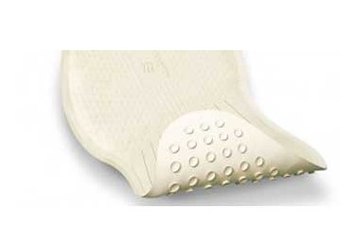
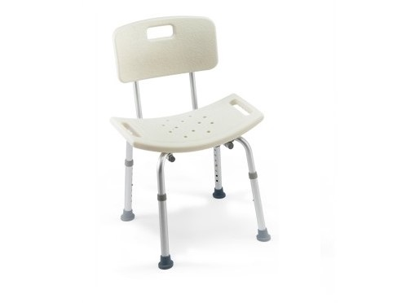


Slide 8
Active Living
Physical Health & Well Being

Slide 9

Movement 1
Home exercises:
  Seated climb; lift your knee, and reach up with the opposite arm
  Stair climb; hold the railing when taking the stairs
  Standing; lift a weight in each hand with elbows bent and at your side
  Marching on the spot; hear yourself breathe, and still be able to talk

Slide 10
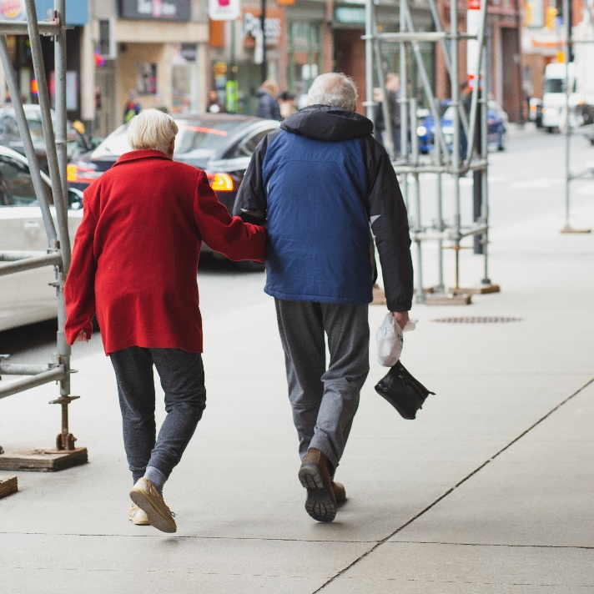
Movement 2
Walking
Cross the road at controlled intersections such as intersections or designated crosswalks.
Avoid crossing in the middle of the block or between parked cars.
At traffic lights, cross when traffic has come to a complete stop. Begin to cross at the start of the green light or “walk” signal

Slide 11
Movement 3
Stay on sidewalks where available.
If a sidewalk isn’t available, be sure to walk on the far side of the road facing traffic.
Discussion
When walking on the sidewalk, which side of the road are you usually on?

Slide 12

Movement 4
Diabetes
&
Physical Activity
Regular physical activity is important for everyone, especially for people living with Diabetes
Diabetes Canada recommends the following aerobic and resistance training activities:
  Aerobic activities
  Resistance activities

Slide 13
Activities
Health Benefits
Examples of aerobics
  Walking, bicycling, or jogging to increase heart rate and breathing
Examples of resistance
  Weights, weight machines, resistance bands, use of own body weight like push-ups (2-3 times weekly)
Weight management
Lower blood sugar
Control blood pressure
Improve strength
Cardiorespiratory fitness
Improve mental health
http://www.bassic.ca/safe-seniors-calendar.html

Slide 14
Fall Prevention – Keep moving!
If you are 65 years of age or older, you can join exercise classes virtually (online) in your community
Exercise classes can help seniors stay active and especially help them improve and maintain balance, strength and mobility
You can reap the many benefits of exercise to live a longer, happy and healthier life!
https://preventfalls.ca/older-adults/

Slide 15

Best Practices
Be safe when moving furniture to prevent falls
Keep items you use regularly within reach, if possible avoid climbing or reaching for things from above so they don’t fall on you
Always use hand railings on stairs if available and keep hands free for extra support [if necessary]
  i.e. going downstairs with a laundry basket or while holding a phone
Avoid lifting heavy objects that may throw off your balance

Slide 16
Government Programs & Financial Assistance
Ontario Drug Benefit (ODB)
You will qualify for this program when you turn 65 years old. Some of you will qualify before you reach that age because you’re:
  Living in a:
    Long-term care home
    Home for special care
    Community Home for Opportunity
  Receiving professional home and community care services
  Receiving benefits from Ontario Works or Ontario Disability Support Program

Slide 17
Government Programs & Financial Assistance
Assistive Devices Program
(ADP)
This program helps people with long-term physical disabilities pay for customized equipment, like wheelchairs and hearing aids.
It also helps cover the cost of specialized supplies, such as those used with ostomies
  Ostomies are surgeries that create openings from an area inside the body to the outside.
  Example: urostomy

Slide 18
Government Programs & Financial Assistance
Ontario Seniors Dental Care Program
(OSDCP)
This program provides free, routine dental services for low-income seniors who are 65 years of age or older.
Coverage
Eligibility

Slide 19
Did you know…
Everyone should be prepared to be self-reliant for at least three (3) days immediately after or during an emergency?

Slide 20
Emergency Preparedness
There are many different types of emergencies that could warrant being prepared for: power outages, severe summer weather, health emergencies, winter storms and hazardous materials incidents.
If you live on your own, you need to have supplies in a three day kit in case you need to shelter in place.
Be familiar with the location of emergency doors/exits in your home in the event that you need to evacuate.
On the next page we’ll explore what you may need if you have to leave quickly
http://www.bassic.ca/safe-seniors-calendar.html

Slide 21
Emergency Preparedness
Assistive devices such as canes, walkers, hearing aids, breathing apparatus, etc…
Prescription eyeglasses & footwear
Extra dentures and cleanser
Extra medication, supplements and a list of your prescriptions
Personal identification and a list of numbers and names for doctors(s), case workers(s), senior’s group contact person, etc…
What else might you include in your emergency kit?

Slide 22
Short Discussion
How do you motivate yourself to stay active?

Slide 23
Thank you
Your feedback is appreciated

