Slide 1
Protecting Yourself Online
Ethno-cultural Seniors:
Staying Healthy, Well and Safe
at Home in Communities
Scams, Fraud, Cyber Security

Slide 2
Topics of Discussion
Introduction
Cyber Safety
Phishing
Identifying Scams & Fraud
Passwords
Protecting Yourself Online
Feedback

Slide 3
Cyber Safety
Emails, Calls, Texts

Slide 4
Did you know?
Setting your software and operating system updates to install automatically means you automatically get the latest features and security patches. Updated security means you’re one step in the right direction of protecting yourself online!

Slide 5
Scams & Fraud
Why do cyber threats exist?
The most common reason is the pursuit of information such as:
Your identity
Banking information
Information about your business / company
Cyber threats can happen to anyone

Slide 6
Spam vs. Phishing
The key difference here is that someone who is phishing has malicious intent.
When they try to acquire your personal information
While spam emails or calls usually try and sell you on a product or service.

Slide 7
Phishing
The word Phishing originated in the 1990s by hackers who were stealing online accounts and passwords.
It’s because they were using email lures, setting up hooks to “fish” for passwords and data from the “sea” of internet users.
https://www.cleo.on.ca/en/publications/scams/what-are-some-common-telephone-and-internet-scams

Slide 8
Examples of Scammer Activity
Calls
Scammers offering vacation deals
Scammers alleging to be Google
Scammers offering free psychic consultations
Scammers offering tech support
Texts
Receiving texts from an unknown sender
Receiving a text that is asking you for personal information – things like passwords, accounts numbers, or even your social security number
Says that ‘they’ have noticed some suspicious activity on your account
Receiving a fake delivery notification

Slide 9
Calls

Slide 10
Calls
Scammers use phone calls to pretend they are the government, your bank, your employer or someone that you owe money to, or even an old friend.
The scammers will ask you all sorts of things that sound legitimate that often results in “identity theft”.
If you receive telephone calls from collection agencies or creditors for accounts you do not have or purchases you didn’t make, you could be a victim of identity theft.
Scammers may use scare tactics related to your immigration status or mention you are in trouble about with the police (i.e. warrants of arrest for you or a family member)

Slide 11
Did you know?
To avoid most telemarketing calls in the future, register on the National Do Not Call List. To register, visit www.Innte-dncl.gc.ca or call 1-866-580-3625

Slide 12
Emails

Slide 13
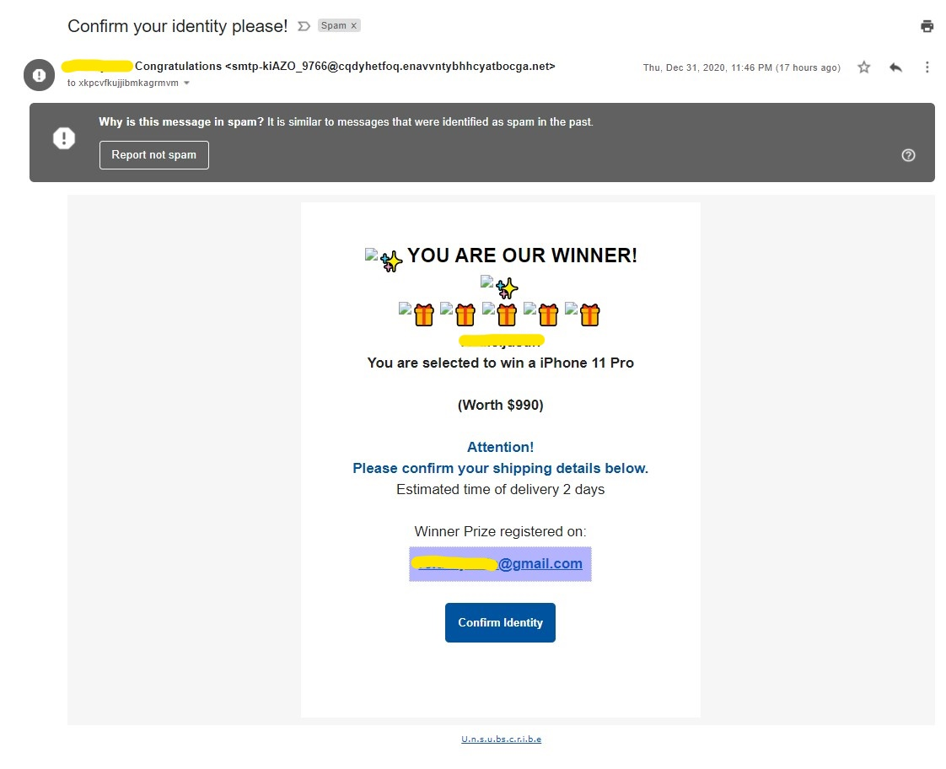

Slide 14
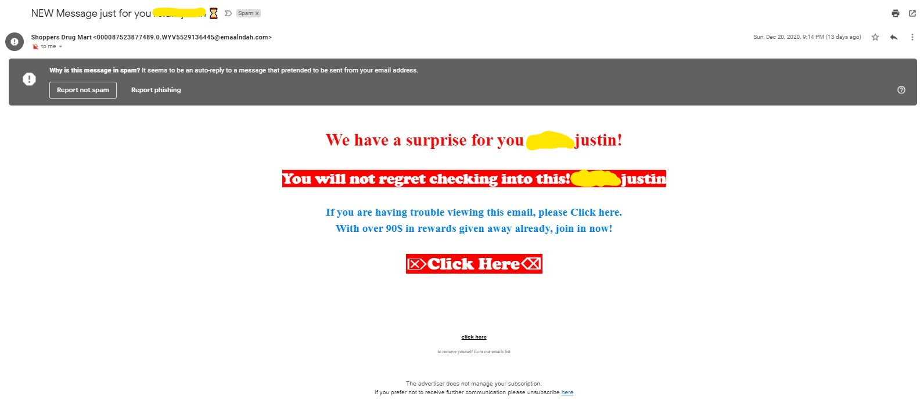

Slide 15
Texting

Slide 16
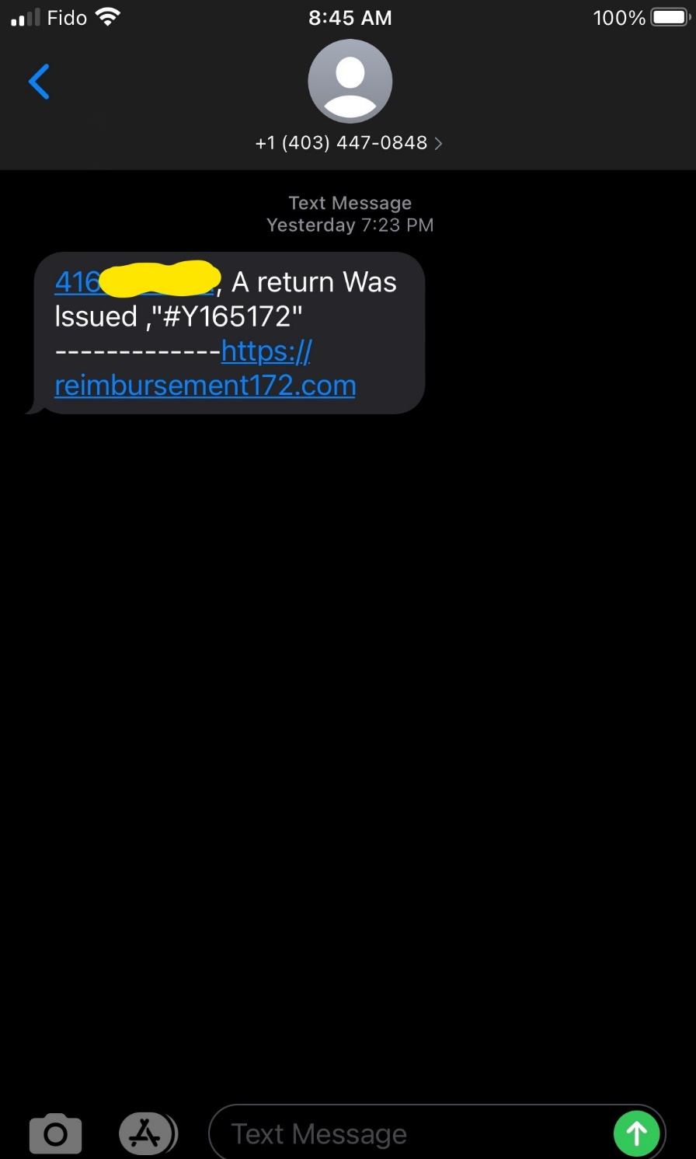
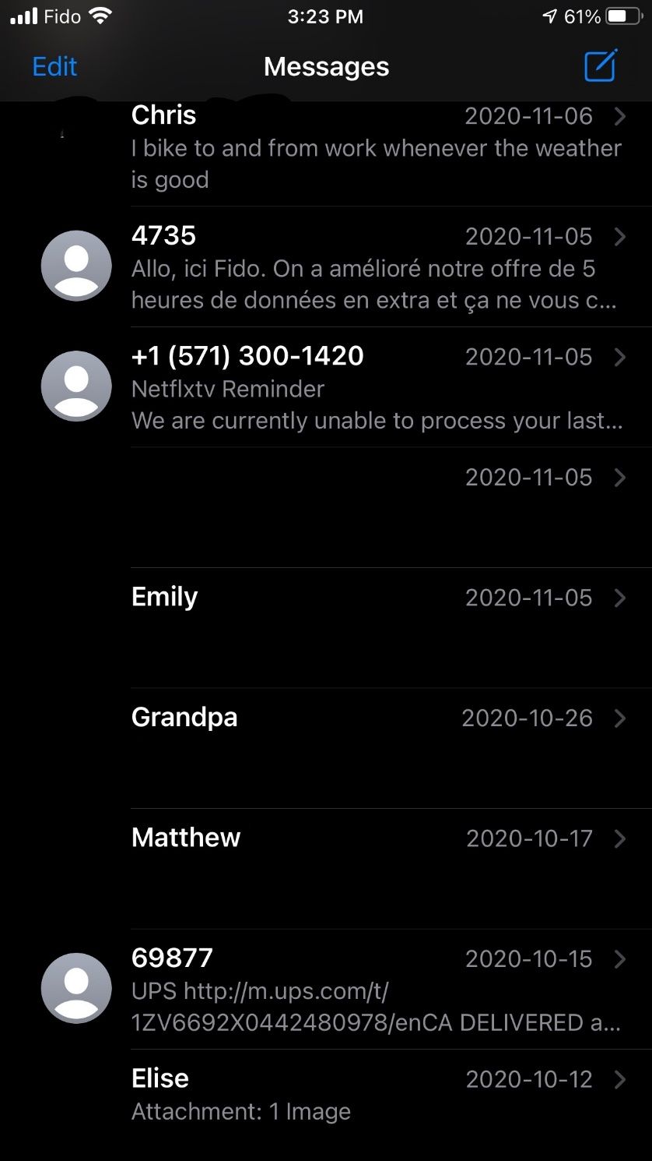
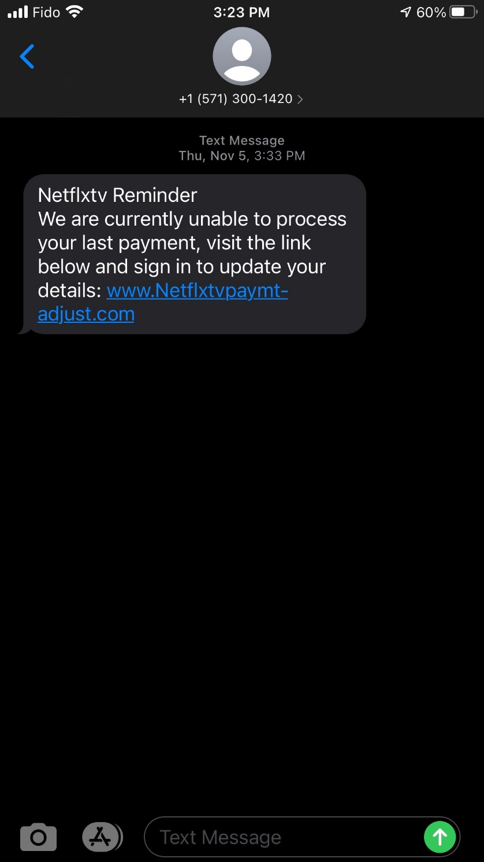

Slide 17
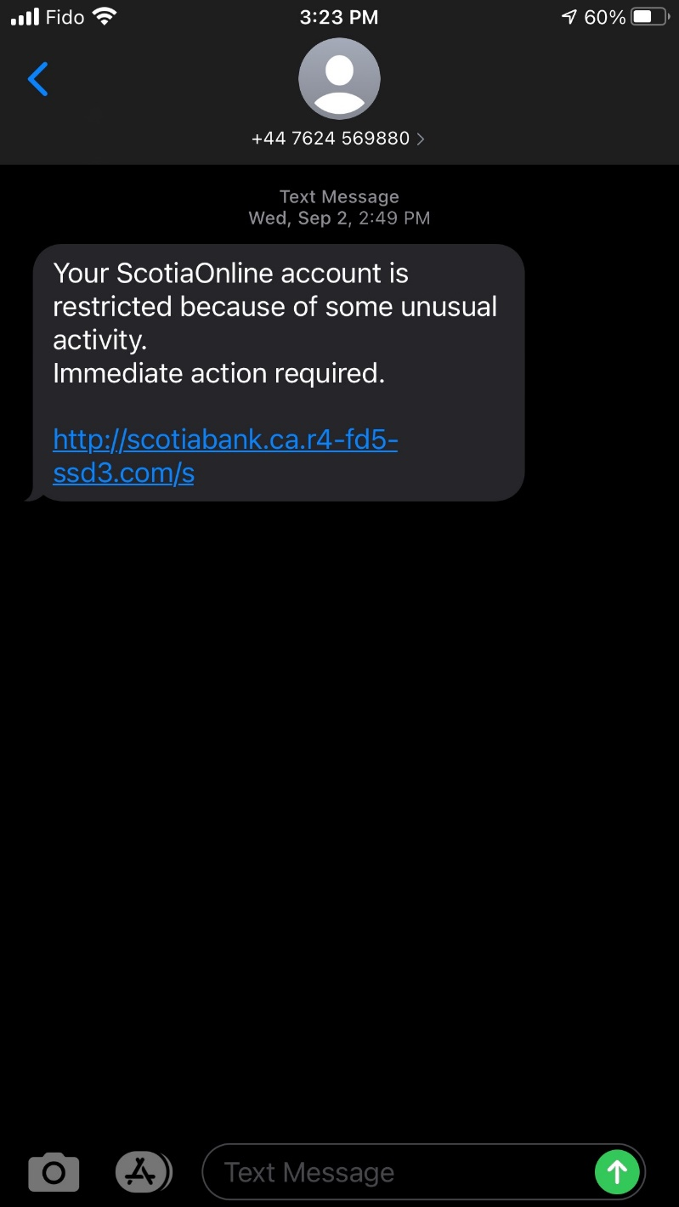
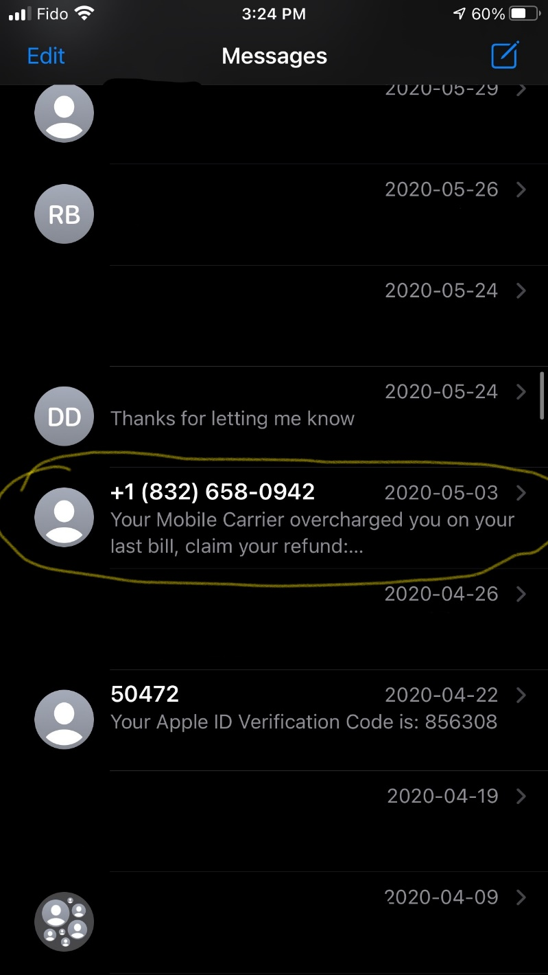

Slide 18
Solution
If you find that someone has used your identity, there are a few things you should do as soon as possible:
Report the identity theft to the police using the local police division number (Dial 311 and ask for the your local police divisions contact information)
Contact the financial institutions, credit card issuers, or companies that are involved
Report the identity theft to the Canadian Anti-Fraud Centre (CAFC)
Cancel any missing identification if it has been compromised
Contact the credit reporting agencies, Equifax and TransUnion if your credit cards have been impacted by a scam; whether it be by phone, text or email

Slide 19
Passwords
USING PASSWORD
AS MY PASSWORD
IS EASY TO REMEMBER!
www.getcybersafe.ca

Slide 20
Did you know?
Using a different password for every account is one of the easiest ways to keep all your accounts safe in the event of a breach.

Slide 21
Tip: A passphrase is a combination of random words you select to secure an account or device Example: fiveredandblueroses
Your password protects your information, identity, and even money from cyber criminals.
Not all passwords are created equal.
Strong passwords are great, but a strong passphrase is even better

Slide 22
Strong
When a passphrase isn’t available [because you must have a number and/or a symbol] making a strong passphrase is recommended.
A strong passphrase can have words, numbers, and symbols:
Depending on your account, symbols that can be used are !, @, #, $
Example:
5redandblueRose$

Slide 23
Traditional Passwords
Use at least eight characters
Use a combination of upper and lower case letters with at least one number
Include at least one character that isn’t a letter or number like: !, # or $

Slide 24
Unique
Many people use the same password for multiple accounts and devices
If a cyber criminal gets access to one of your accounts, they get access to all them if you are using the same passwords
Using different passwords is the easiest way to protect all of your accounts in case of a breach

Slide 25
Did you know?
Having a dedicated password book will help keep you organized in case you ever forgot your passwords. Many people save their passwords on their phones and tablets, but what happens if you can’t remember how to get into those too!

Slide 26
Did you know?
Backing up your data means sending it to the cloud or copying it to an external hard drive.

Slide 27
Protecting Yourself Online
Review

Slide 28
Review
Be suspicious of unknown numbers and emails
Write down your passwords in a dedicated password notebook
Use a passphrase instead of password
Retailers asking for emails
If something in a text, email or phone call seems too good to be true, then it probably is!

Slide 29
Thank You
Feedback

