Slide 1
Staying Connected
Ethno-cultural Seniors:
Staying Healthy, Well and Safe
at Home in Communities
Using Technology

Slide 2
Topics of Discussion
Introduction
Communication
What is the internet?
How does it work?
Using technology to stay connected
Social Media

Slide 3
Communication

Slide 4
What is the internet? How does it work?
The internet allows digital devices to talk to one another
It allows information to travel
Speed of light, that’s really fast!
Cables, cables and more cables
It works the way we want it too!
https://www.theguardian.com/technology/2018/oct/22/what-is-the-internet-13-key-questions-answered

Slide 5
Staying Connected
Telephones
Landline
Mobile
Computers
Tablets
Smart devices

Slide 6
Schedule Virtual Visits

Slide 7
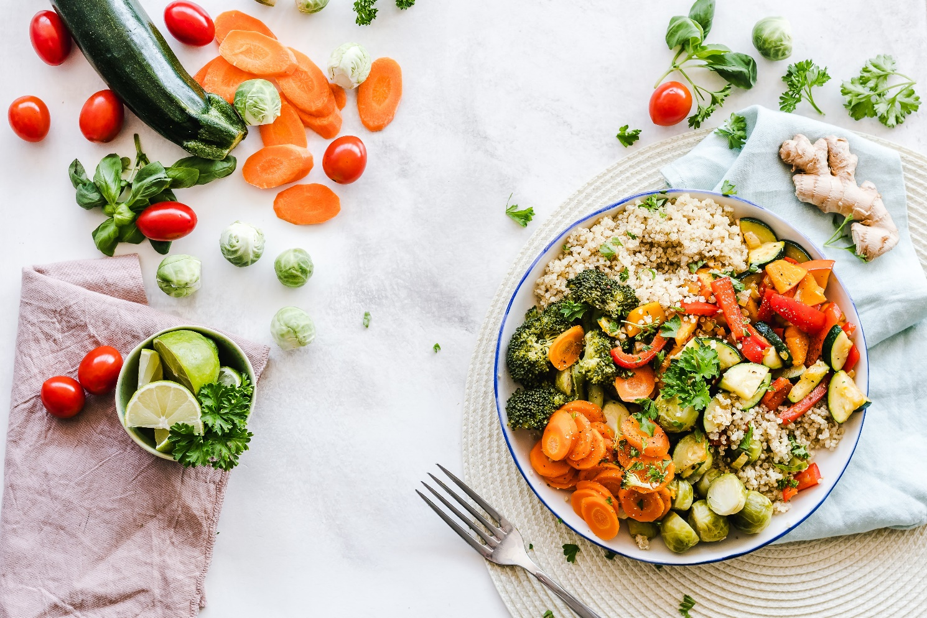
Schedule Virtual Dinner Parties

Slide 8
Emails vs. Mail

Slide 9
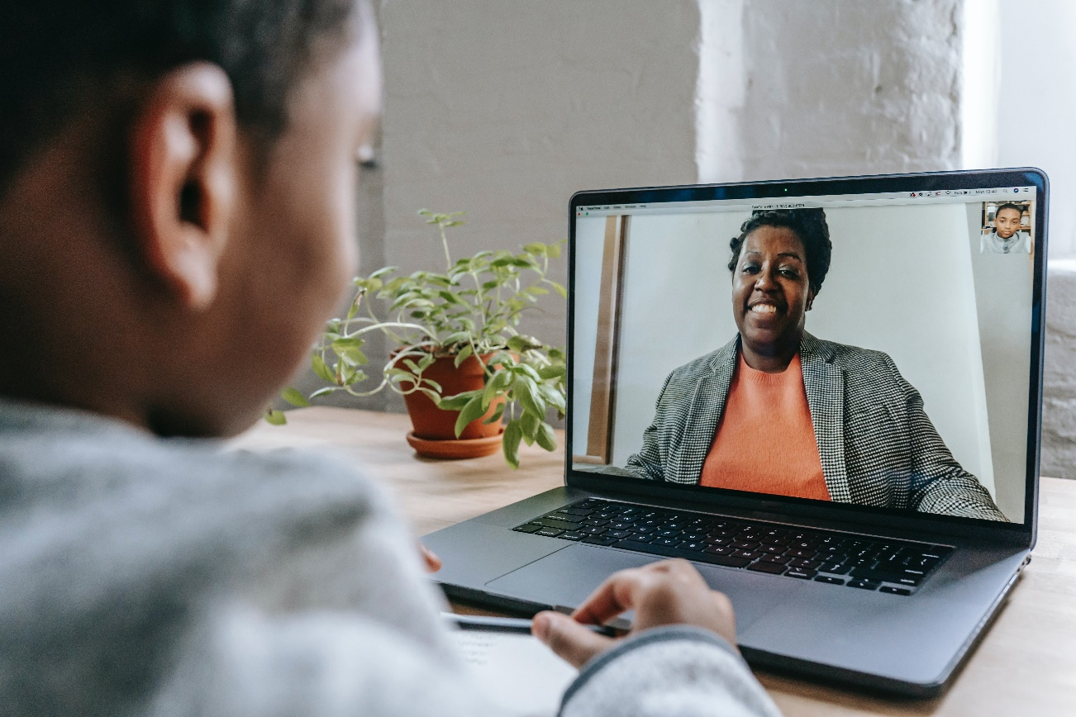
Join in Online

Slide 10
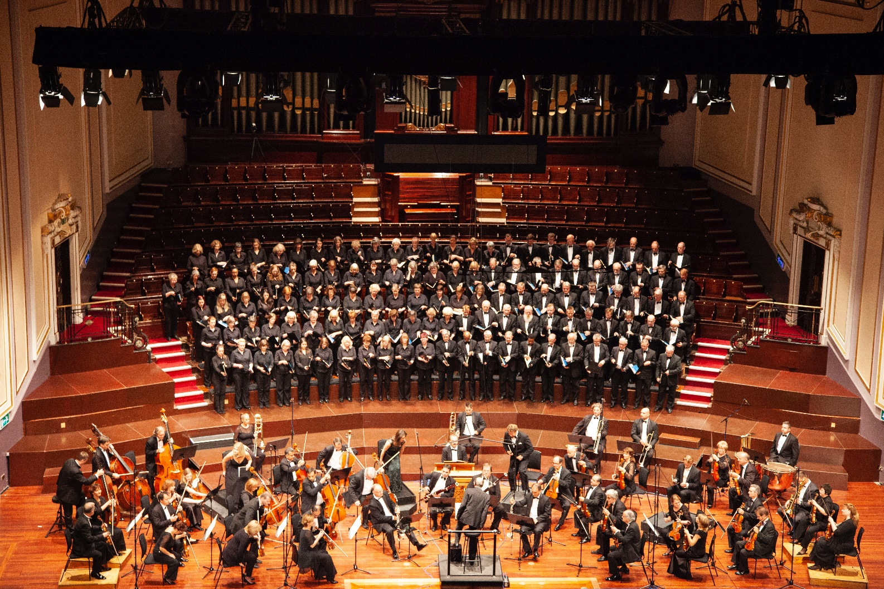
Live Virtual Concerts
https://www.eventbrite.ca/o/waveland-canada-17946480096

Slide 11
Bedtime Stories

Slide 12
Spiritual Activities

Slide 13
Social Media
Social media is…
How do we use social media?
Staying connected with social media
Applications / Programs
Less is more approach
Screen fatigue
Notifications

Slide 14
Review
Be suspicious of unknown numbers and emails
Try choosing 1-3 social media platforms
Just because someone texts you it doesn’t mean to you have text them back, call them instead
Turn off or minimize the amount of alerts and notifications
Write down your passwords in a dedicated password notebook

Slide 15
Thank You
Feedback

